Slide 1


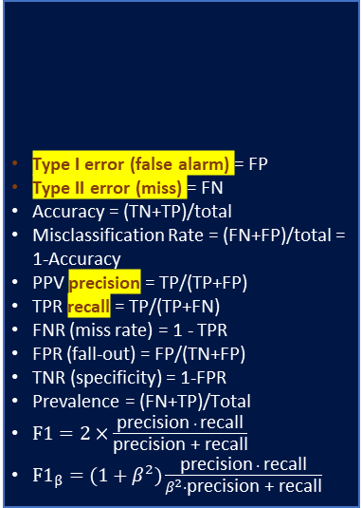
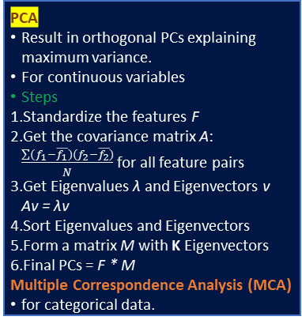
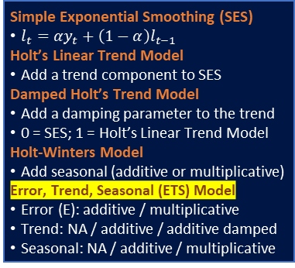
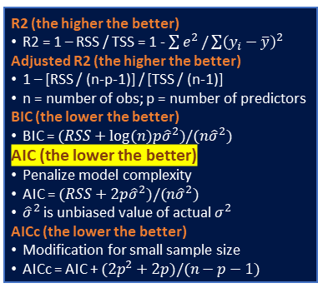
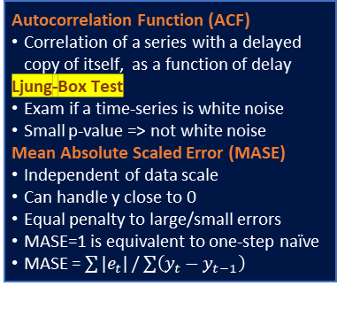
4 Assumptions of Linear Regression
Linear in parameters
Independent X
No perfect multicollinearity
X not correlated to residuals
Residuals
0 mean
equal variance
no autocorrelation
normality
Normal X and Y if maximum likelihood
Logistics Regression
Loss (cost) function is Log Loss
K-means Clustering
To minimize within-cluster-variation
Standardized continuous variables
Generalization (Gaussian Mixture)
No need standardized features
k-modes, k-prototypes
Non continuous variables
Optimal number of K
Silhouette coefficient [-1 1] 1 is best
(b – a) / max(a, b)
a: mean intra-cluster dist of each obs
b:mean nearest-cluster dist each obs
Steps
Randomly select centroids.
Assign all points to closest centroids.
Recompute centroids of newly formed clusters.
Repeat 2 and 3.
Non-continuous variables
K-modes (categorical)
K-prototypes (mixed): partition
Gower distance (mixed)
Continuous: abs(diff)/range
Categorical: same = 0, diff = 1
Entropy
Level of information/uncertainty
Entropy of a discrete random variable X with n possible outcomes:
Split: max extra-group, min intra-group
Relative Entropy (KL Divergence)
How one probability distribution (PD) is different from a reference PD.
For discrete probability P and Q defined on the same probability space X, the relative entropy from Q to P:
Autocorrelation Function (ACF)
Correlation of a series with a delayed copy of itself, as a function of delay
Ljung-Box Test
Exam if a time-series is white noise
Small p-value => not white noise
Mean Absolute Scaled Error (MASE)
Independent of data scale
Can handle y close to 0
Equal penalty to large/small errors
MASE=1 is equivalent to one-step naïve
MASE = $\sum{|e_{t}|}/\sum{\left(y_{t}−y_{t−1}\right)}$
Type I error (false alarm) = FP
Type II error (miss) = FN
Accuracy = (TN+TP)/total
Misclassification Rate = (FN+FP)/total = 1-Accuracy
PPV precision = TP/(TP+FP)
TPR recall = TP/(TP+FN)
FNR (miss rate) = 1 - TPR
FPR (fall-out) = FP/(TN+FP)
TNR (specificity) = 1-FPR
Prevalence = (FN+TP)/Total
$F1=2×\frac{\text{precision} ∙ \text{recall}}{\text{precision}\text{ + }\text{recall}}$
$F1_{β}=(1+β^{2})\frac{\text{precision} ∙ \text{recall}}{β^{2}∙\text{precision}\text{ + }\text{recall}}$
 |  | predictions
 |  | 0 | 1
actual | 0 | TN | FP
 | 1 | FN | TP
L1 Regularization
Penalize sum absolute of weights
Achieve sparsity
L2 Regularization
Penalize sum square of weights
Less sensitive to outliers
PCA
Result in orthogonal PCs explaining maximum variance.
For continuous variables
Steps
Standardize the features F
Get the covariance matrix A: $\frac{\sum{(f_{1}−\overline{f_{1}})(f_{2}−\overline{f_{2}})}}{N}$ for all feature pairs
Get Eigenvalues λ and Eigenvectors v Av = λv
Sort Eigenvalues and Eigenvectors
Form a matrix M with K Eigenvectors
Final PCs = F * M
Multiple Correspondence Analysis (MCA)
for categorical data.
R2 (the higher the better)
R2 = 1 – RSS / TSS = 1 - $\sum{e^{2}}/\sum{{\left(y_{i}−\overline{y}\right)}^{2}}$
Adjusted R2 (the higher the better)
1 – [RSS / (n-p-1)] / [TSS / (n-1)]
n = number of obs; p = number of predictors
BIC (the lower the better)
BIC = $(RSS+log⁡(n)p{\hat{σ}}^{2})/(n{\hat{σ}}^{2})$
AIC (the lower the better)
Penalize model complexity
AIC = $(RSS+2p{\hat{σ}}^{2})/(n{\hat{σ}}^{2})$
${\hat{σ}}^{2}$ is unbiased value of actual $σ^{2}$
AICc (the lower the better)
Modification for small sample size
AICc = AIC + $(2p^{2}+2p)/(n−p−1)$
Simple Exponential Smoothing (SES)
$l_{t}=αy_{t}+\left(1−α\right)l_{t−1}$
Holt’s Linear Trend Model
Add a trend component to SES
Damped Holt’s Trend Model
Add a damping parameter to the trend
0 = SES; 1 = Holt’s Linear Trend Model
Holt-Winters Model
Add seasonal (additive or multiplicative)
Error, Trend, Seasonal (ETS) Model
Error (E): additive / multiplicative
Trend: NA / additive / additive damped
Seasonal: NA / additive / multiplicative
Bagging (Bootstrap Aggregating)
Bootstrap
Repeatedly sample with replacement
Form N models with the same bias
On average takes around 2/3 of data
Averaging to reduce variance
Random Forest
Also sample m predictors before split
Biased toward frequent classes
Boosting
Iteratively build weak classifiers
At each iteration, assign more weight to observations with larger error
Sensitive to outliers
ARIMA
Autoregressive: p lagged observations
Moving Average: q lagged errors
d number of differencing
Seasonal ARIMA(p,d,q)(P,D,Q)m
(P,D,Q): seasonal diff and lags
m: number of obs per period
Dynamic Regression (ARIMA X)
Combine external predictors
Model error term as ARIMA process
Dynamic Harmonic Regression
Non-seasonal ARIMA + Fourier terms
Assume fixed seasonal patterns
Central Limit Theorem
Sample means are normally distributed
Maximum Likelihood Estimation (MLE)
Parameter (point) estimation
Formulate log-likelihood based on assumed distribution
Optimize with gradient descent, quasi-newton etc.
Shapiro-Wilk Test
H0: Normally Distributed
t-test
Compare means of two samples
Assumption: sample from normal (with equal variances if Student)
H0: equal (large/small)
ANOVA
Compare means of multiple samples
Assumption: independent, normal, homoscedasticity (equal variances)
H0: equal
F-test
Compare variances of two samples
Assumption: sample from normal
H0: equal (large/small)
Chi-Square Test
Independence between two categorical variables
H0: independent
Stationary
Constant mean, variance, autocorrelation over time.
Box-Cox Transformation
Variance Stabilization
Useful for ts with increasing variation
Useful to ARIMA (but not ETS)
Differencing (non-seasonal / seasonal)
Mean Stabilization
Shapley Value
Distribution of payoff among players
Under fair conditions:
no waste: all payoff distributed
Equal contribution, equal payoff
Zero contribution, zero payoff
The game cannot be divided further
Avg expected marginal contribution of a player from all possible combinations.
VARMA
Vector ARMA: generalized to multivariate time-series.

Slide 2
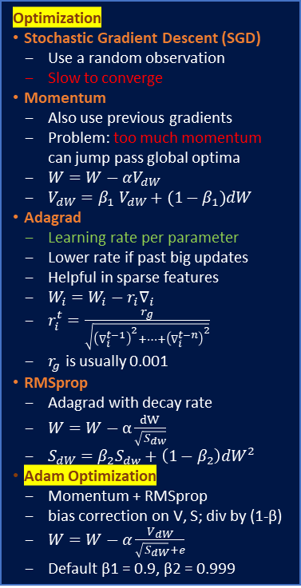
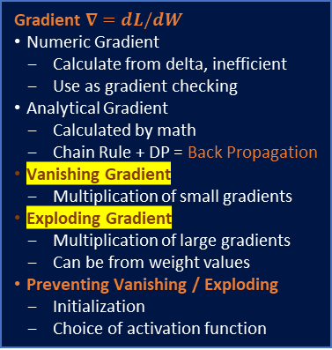
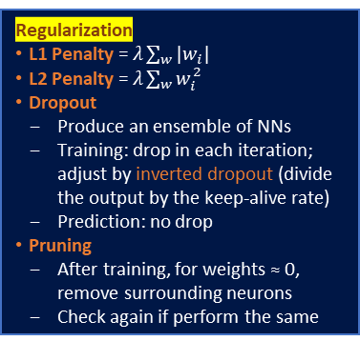
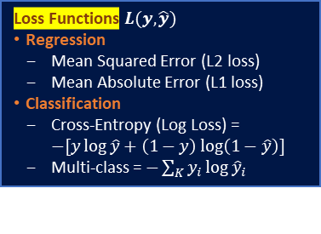
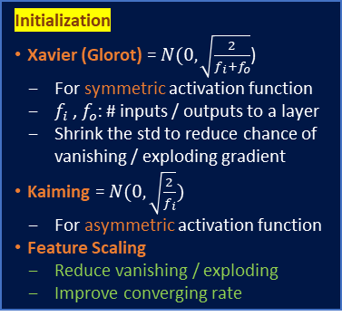
Basics
Forward Pass: prediction and loss
Back Propagation: update weights
Activation Functions
ReLU (asymmetric)
Not differentiable; do sub-gradient
Computational efficient
Sparsity can reduce overfitting
Uncapped – likely to explode
Dying ReLU: once 0 always 0
Leaky ReLU (asymmetric)
Slope for negative to prevent dying
Sigmoid (symmetric)
Output 0 to 1
Capped – reduce explode chance
Tanh (symmetric)
Output -1 to 1
Output Nodes
Sigmoid: binary classification
Softmax: multi-class classification
Linear: regression
Gradient $∇=dL/dW$
Numeric Gradient
Calculate from delta, inefficient
Use as gradient checking
Analytical Gradient
Calculated by math
Chain Rule + DP = Back Propagation
Vanishing Gradient
Multiplication of small gradients
Exploding Gradient
Multiplication of large gradients
Can be from weight values
Preventing Vanishing / Exploding
Initialization
Choice of activation function
Optimization
Stochastic Gradient Descent (SGD)
Use a random observation
Slow to converge
Momentum
Also use previous gradients
Problem: too much momentum can jump pass global optima
$W=W−αV_{dW}$
$V_{dW}=β_{1} V_{dW}+(1−β_{1})dW$
Adagrad
Learning rate per parameter
Lower rate if past big updates
Helpful in sparse features
$W_{i}=W_{i}−r_{i}∇_{i}$
$r_{i}^{t}=\frac{r_{g}}{\sqrt{{\left(∇_{i}^{t−1}\right)}^{2}+…+{\left(∇_{i}^{t−n}\right)}^{2}}}$
$r_{g}$ is usually 0.001
RMSprop
Adagrad with decay rate
$W=W−α\frac{dW}{\sqrt{S_{dw}}}$
$S_{dW}=β_{2}S_{dw}+\left(1−β_{2}\right)dW^{2}$
Adam Optimization
Momentum + RMSprop
bias correction on V, S; div by (1-β)
$W=W−α\frac{V_{dW}}{\sqrt{S_{dW}}+e}$
Default β1 = 0.9, β2 = 0.999
Wide or Deep?
Deep usually needs fewer parameters
Start with One Hidden Layer
# neurons = (inputs + outputs )/2
Start with Multiple Hidden Layers
With more layers, nodes than needed
Then prune the network
Loss Functions $L(y,\hat{y})$
Regression
Mean Squared Error (L2 loss)
Mean Absolute Error (L1 loss)
Classification
Cross-Entropy (Log Loss) = $−[y\log{\hat{y}}+\left(1−y\right)\log\left(1−\hat{y}\right)]$
Multi-class = $−\sum_{K}{y_{i}\log{{\hat{y}}_{i}}}$
Initialization
Xavier (Glorot) = $N(0, \sqrt{\frac{2}{f_{i}+f_{o}}}$)
For symmetric activation function
$f_{i}$ , $f_{o}$: # inputs / outputs to a layer
Shrink the std to reduce chance of vanishing / exploding gradient
Kaiming = $N(0, \sqrt{\frac{2}{f_{i}}})$
For asymmetric activation function
Feature Scaling
Reduce vanishing / exploding
Improve converging rate
Regularization
L1 Penalty = $λ\sum_{w}{|w_{i}|}$
L2 Penalty = $λ\sum_{w}{w_{i}^{2}}$
Dropout
Produce an ensemble of NNs
Training: drop in each iteration; adjust by inverted dropout (divide the output by the keep-alive rate)
Prediction: no drop
Pruning
After training, for weights ≈ 0, remove surrounding neurons
Check again if perform the same

Slide 3
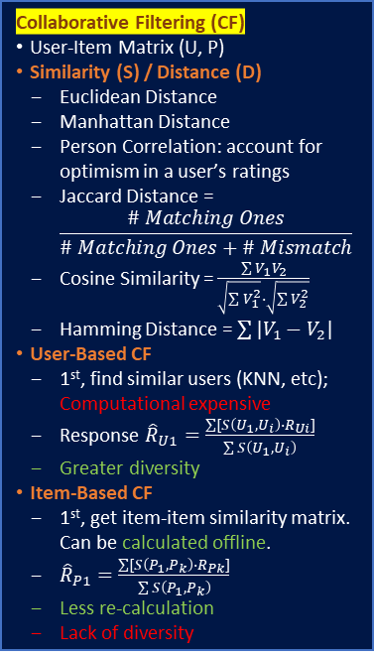
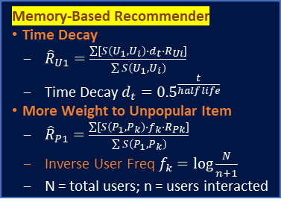
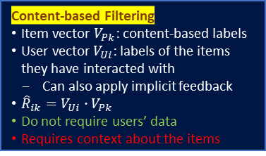
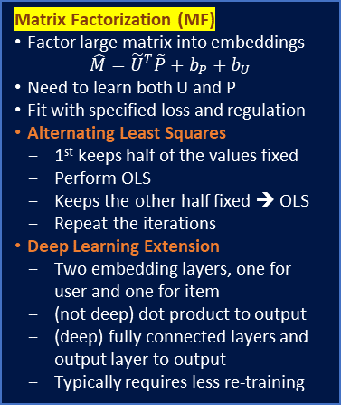
Collaborative Filtering (CF)
User-Item Matrix (U, P)
Similarity (S) / Distance (D)
Euclidean Distance
Manhattan Distance
Person Correlation: account for optimism in a user’s ratings
Jaccard Distance = $\frac{\# Matching Ones}{\# Matching Ones+\# Mismatch}$
Cosine Similarity = $\frac{\sum{V_{1}V_{2}}}{\sqrt{\sum{V_{1}^{2}}}∙\sqrt{\sum{V_{2}^{2}}}}$
Hamming Distance = $\sum{{|V}_{1}−V_{2}|}$
User-Based CF
1st, find similar users (KNN, etc); Computational expensive
Response ${\hat{R}}_{U1}=\frac{\sum{[S\left(U_{1},U_{i}\right)∙R_{Ui}]}}{\sum{S\left(U_{1},U_{i}\right)}}$
Greater diversity
Item-Based CF
1st, get item-item similarity matrix. Can be calculated offline.
${\hat{R}}_{P1}=\frac{\sum{[S\left(P_{1},P_{k}\right)∙R_{Pk}]}}{\sum{S\left(P_{1},P_{k}\right)}}$
Less re-calculation
Lack of diversity
Implicit Rating
Calculated from user behavior
Content-based Filtering
Item vector $V_{Pk}$: content-based labels
User vector $V_{Ui}$: labels of the items they have interacted with
Can also apply implicit feedback
${\hat{R}}_{ik}=V_{Ui}∙V_{Pk}$
Do not require users’ data
Requires context about the items
Matrix Factorization (MF)
Factor large matrix into embeddings $\hat{M}={\tilde{U}}^{T}\tilde{P}+b_{P}+b_{U}$
Need to learn both U and P
Fit with specified loss and regulation
Alternating Least Squares
1st keeps half of the values fixed
Perform OLS
Keeps the other half fixed ➔ OLS
Repeat the iterations
Deep Learning Extension
Two embedding layers, one for user and one for item
(not deep) dot product to output
(deep) fully connected layers and output layer to output
Typically requires less re-training
Memory-Based Recommender
Time Decay
${\hat{R}}_{U1}=\frac{\sum{[S\left(U_{1},U_{i}\right)∙d_{t}∙R_{Ui}]}}{\sum{S\left(U_{1},U_{i}\right)}}$
Time Decay $d_{t}={0.5}^{\frac{t}{half life}}$
More Weight to Unpopular Item
${\hat{R}}_{P1}=\frac{\sum{[S\left(P_{1},P_{k}\right)∙f_{k}∙R_{Pk}]}}{\sum{S\left(P_{1},P_{k}\right)}}$
Inverse User Freq $f_{k}=\log{\frac{N}{n+1}}$
N = total users; n = users interacted
Challenges of CF
Cold Start
No prefect solution
Recommend popular / random
Echo Chamber
User behavior is reinforced by the recommendations themselves
To introduce diversity
Shilling Attack
Users manipulate interactions
Allow only one user per phone, etc

